Slide 1




Abdulrahman Aldossari, Abdullah Balqsim, Abdulghani Khayat
ATTACK SCENARIOS
SERVICE VS HONEYPOT
ICS 344: Information Security

Slide 2
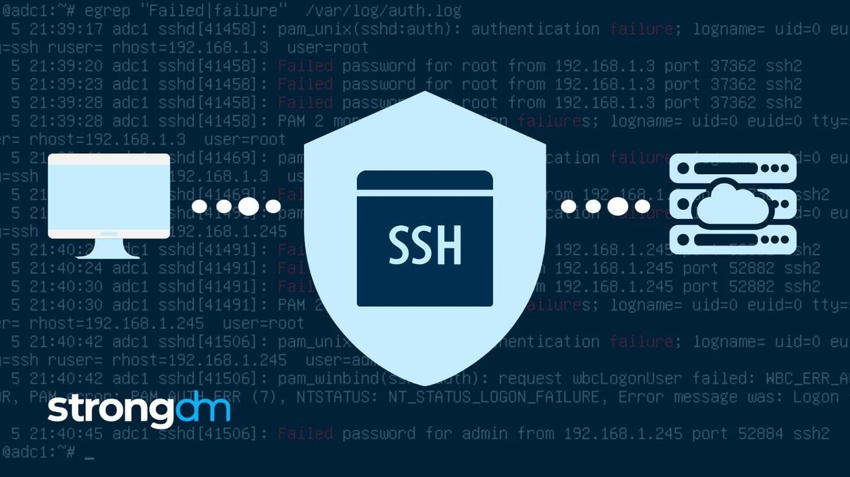
Service: SSH for its critical role in system administration.
Honeypot: Opencanary for lightweight, low-interaction simulation.
ICS 344: Information Security

Slide 3


ATTACK SCENARIOS
Service Attacks:
Tools: Hydra, Metasploit, Custom Scripts.
Techniques: Brute force, Privilege escalation using DirtyCow.
Nix File and Directory Discovery
Extract SSH Keys
Honeypot Attacks:
Similar tools and techniques as the service.
Challenges due to low interaction (limited simulation of SSH).

Slide 4

The comparison between the real SSH service and the Opencanary honeypot revealed notable differences. The real service supported modern and secure algorithms, while the honeypot included weaker, outdated algorithms, indicating a lack of alignment with advanced security practices. Furthermore, while both supported SSH Protocol 2, the OpenSSH versions differed, with the honeypot running an older version. These disparities highlight the honeypot's limitations in fully mimicking the real service, potentially impacting the realism of attack simulations and the accuracy of results.
SERVICE VS THE HONEYPOT.

Slide 5

KEY FINDINGS –
TOOLS EFFECTIVENESS
Caldera:
Effective for automation (e.g., brute-force attacks).
Require troubleshooting during setup.
Kali Tools (Hydra, Metasploit):
Offered manual control and flexibility.
Custom Scripts:
Enhanced testing of specific vulnerabilities.

Slide 6
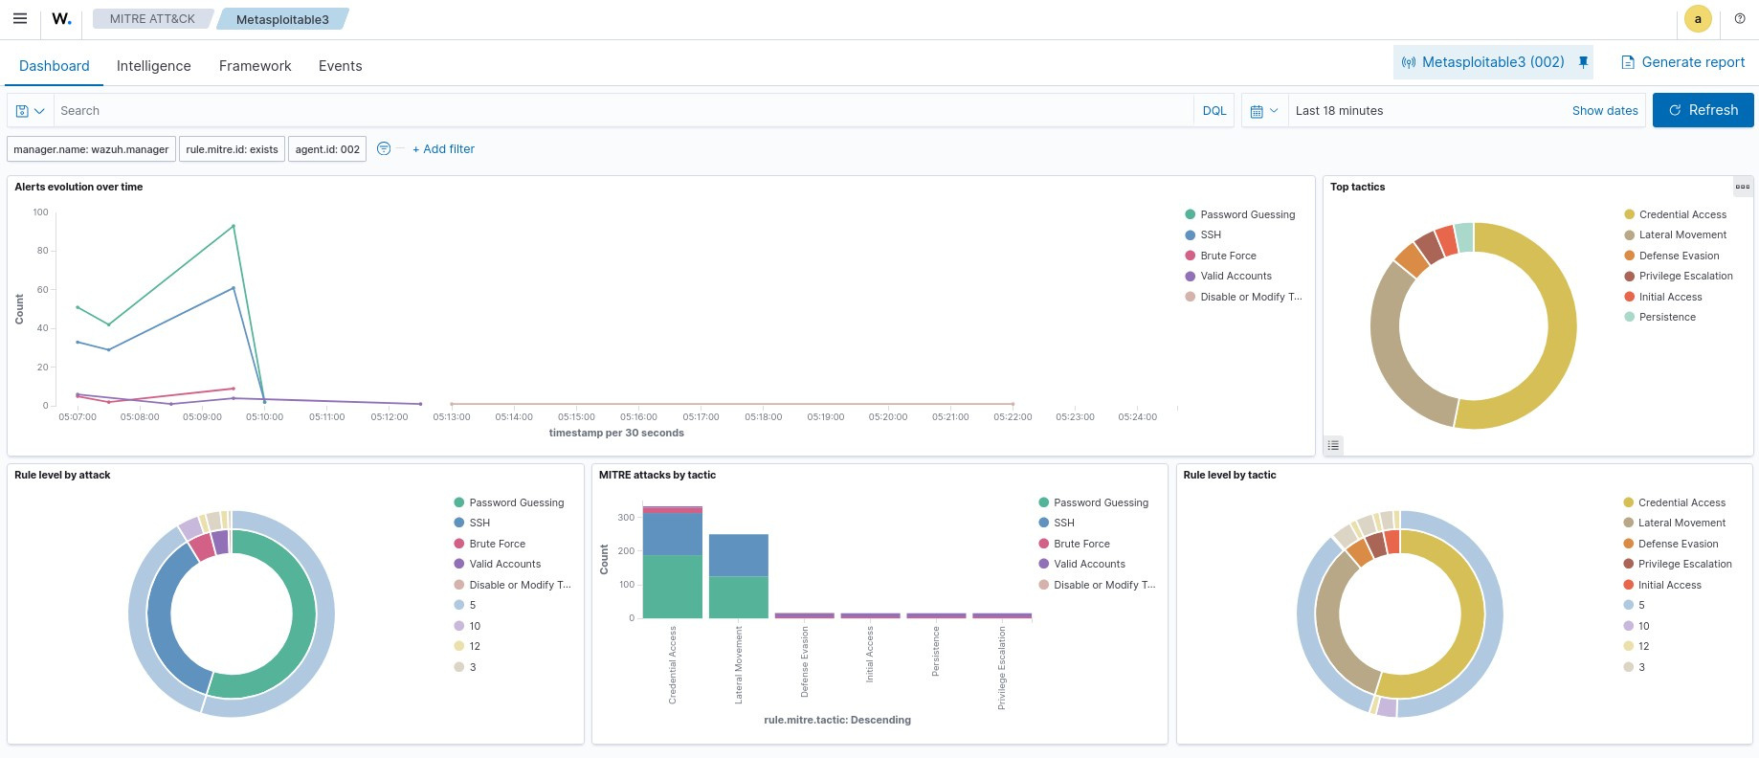
caldera-ssh

Slide 7
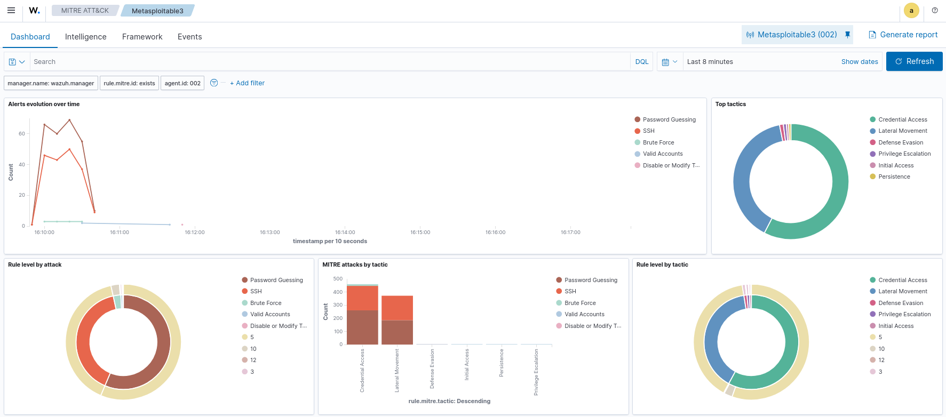
Manual-ssh

Slide 8
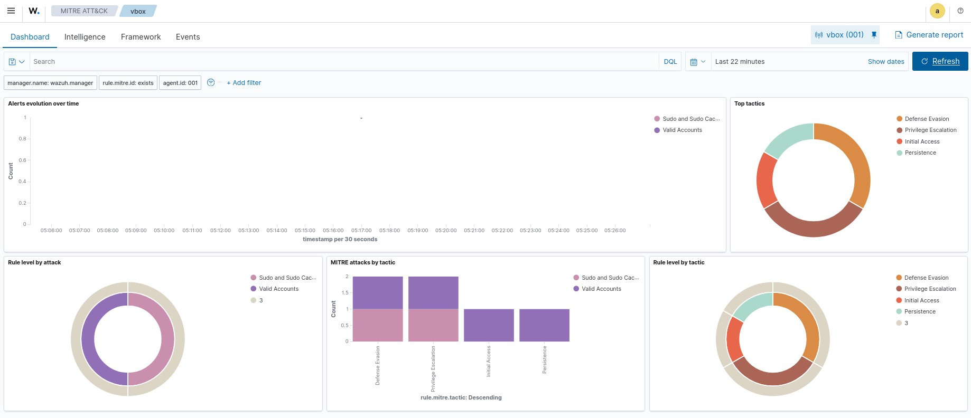
Caldera-honeypot

Slide 9
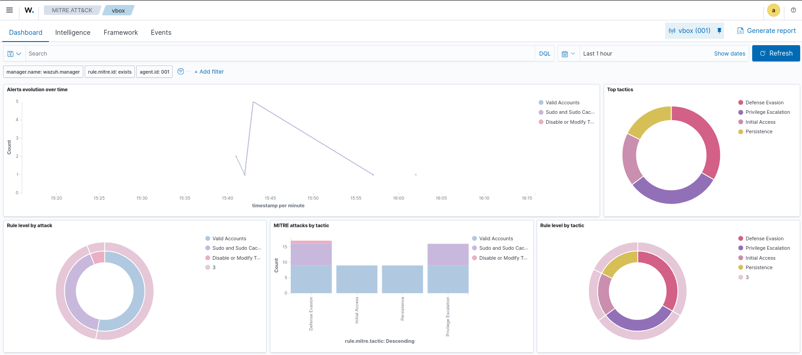
manual-honeypot

Slide 10

SIEM
ANALYSIS
The SIEM analysis using Wazuh provided valuable insights into the behavior and detection of attacks on both the real SSH service and the honeypot. The dashboard highlighted activities related to MITRE ATT&CK tactics, such as privilege escalation, credential access, and initial access, with a clear mapping of detected techniques. Alert evolution over time illustrated the frequency and timing of attacks, with significant patterns aligning with the simulated scenarios. However, the honeypot's low interaction capabilities limited its ability to simulate realistic responses, resulting in fewer detailed alerts compared to the real service. This analysis emphasized the importance of a well-configured SIEM in monitoring and correlating security events for both real systems and honeypots.

Slide 11
THANK
YOU!

